Slide 1
Information Session
Sounds-Write
For Parents and Carers
Notes:
Welcome…….
Learning to read and write opens up a world of opportunities for your children. They will use these newly developed skills to access new knowledge, to develop their creativity, and to enjoy books. They will move from learning to read to reading to learn and reading for enjoyment.
Your children are learning to read and write using Sounds-Write, a phonics program that is very structured and, as you will see today, very logical and good fun! In this session, I/we will introduce you to some basic principles of Sounds-Write and do some of the activities that your children will be doing their Literacy Clinic sessions.

Slide 2
Notes:
SPELD SA acknowledges that we are meeting on the traditional land of the Kaurna people and recognise Kaurna as the Traditional Owner and Custodians of the Adelaide Plains. We recognise and respect their cultural heritage, beliefs and relationship with the land, sea, waterways and sky. We acknowledge that they are of continuing importance to the Kaurna people living today.
The artwork on the screen is by Elizabeth Close, commissioned for the SPELD SA Phonic Book Project.

Slide 3
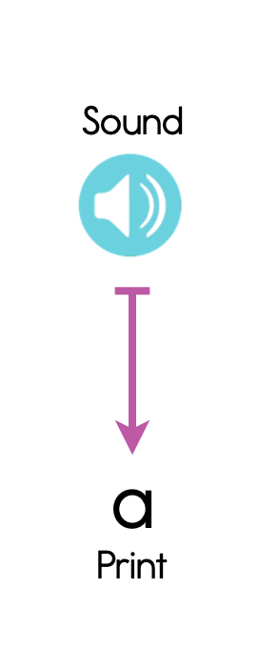
What is Sounds-Write
Linguistic Phonics Program – Starts from the sounds of English and matches them to the spellings

Slide 4
What is Sounds-Write
Reading and Spelling Program – For whole class teaching from Reception to Year 6 and for 1:1 and small group teaching
Evidence Based Program – Based on research into how students best learn to read and spell
Directly teaches the skills, concepts and knowledge students need
Moves from simple to complex
Start with sounds, not letter names
Teaches sounds within the context of words
Multisensory
Scope to support and challenge students
Students enjoy it!

Slide 5
Pronunciation in Sounds-Write
Focuses on precise pronunciation of sounds of the English language
https://www.youtube.com/embed/a8ZMfYjdN-s

Slide 6
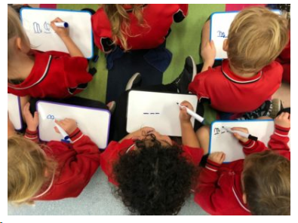
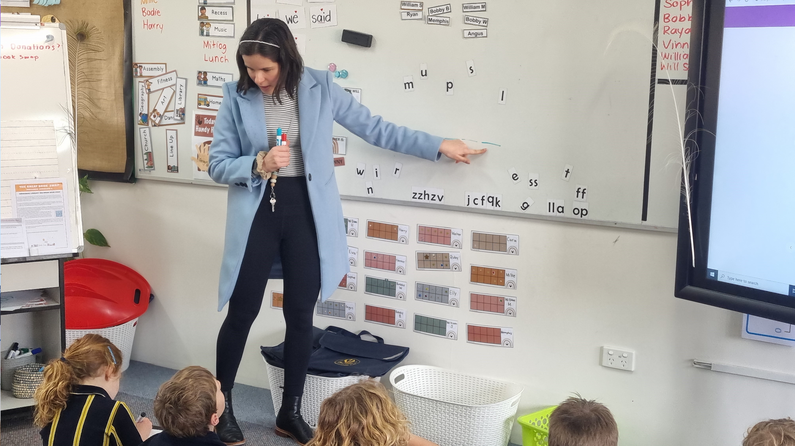
Sounds-Write in Action!

Slide 7
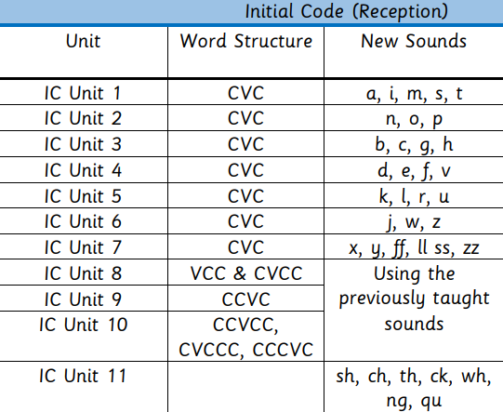
Code Knowledge in Sounds-Write
Sounds-Write teaches code knowledge: how to spell the sounds in the language

Slide 8
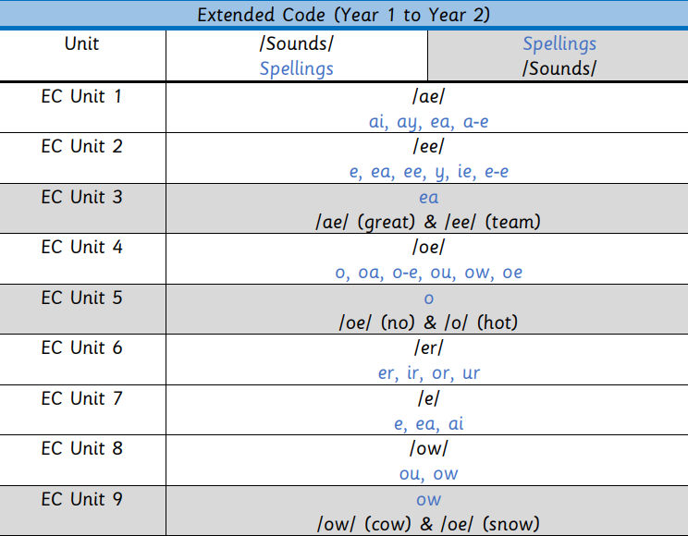
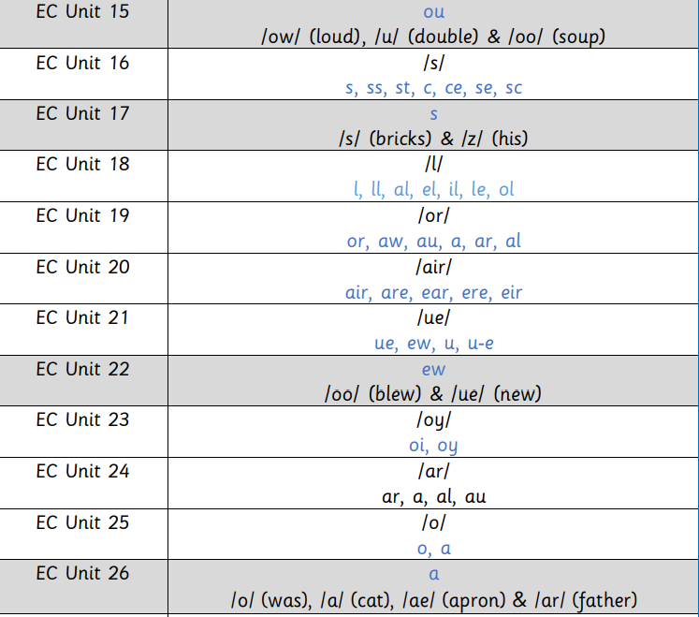
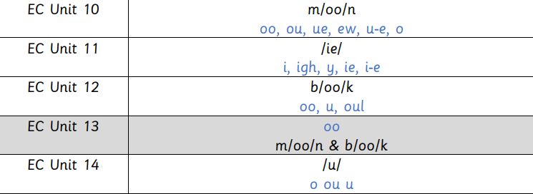
Code Knowledge in Sounds-Write

Slide 9
Make sense of phonics
Offer consolidation of what has been learned in the phonics lesson
Develop good, reliable decoding skills and discourage guessing and relying on memorisation of words!
Develop independent readers
Offer reading success
Decodable Readers

Slide 10
The reader will need to be exposed to the new learning multiple times before it is embedded in long-term memory
It is advisable to read the book more than once to develop fluency
Decodable Readers

Slide 11
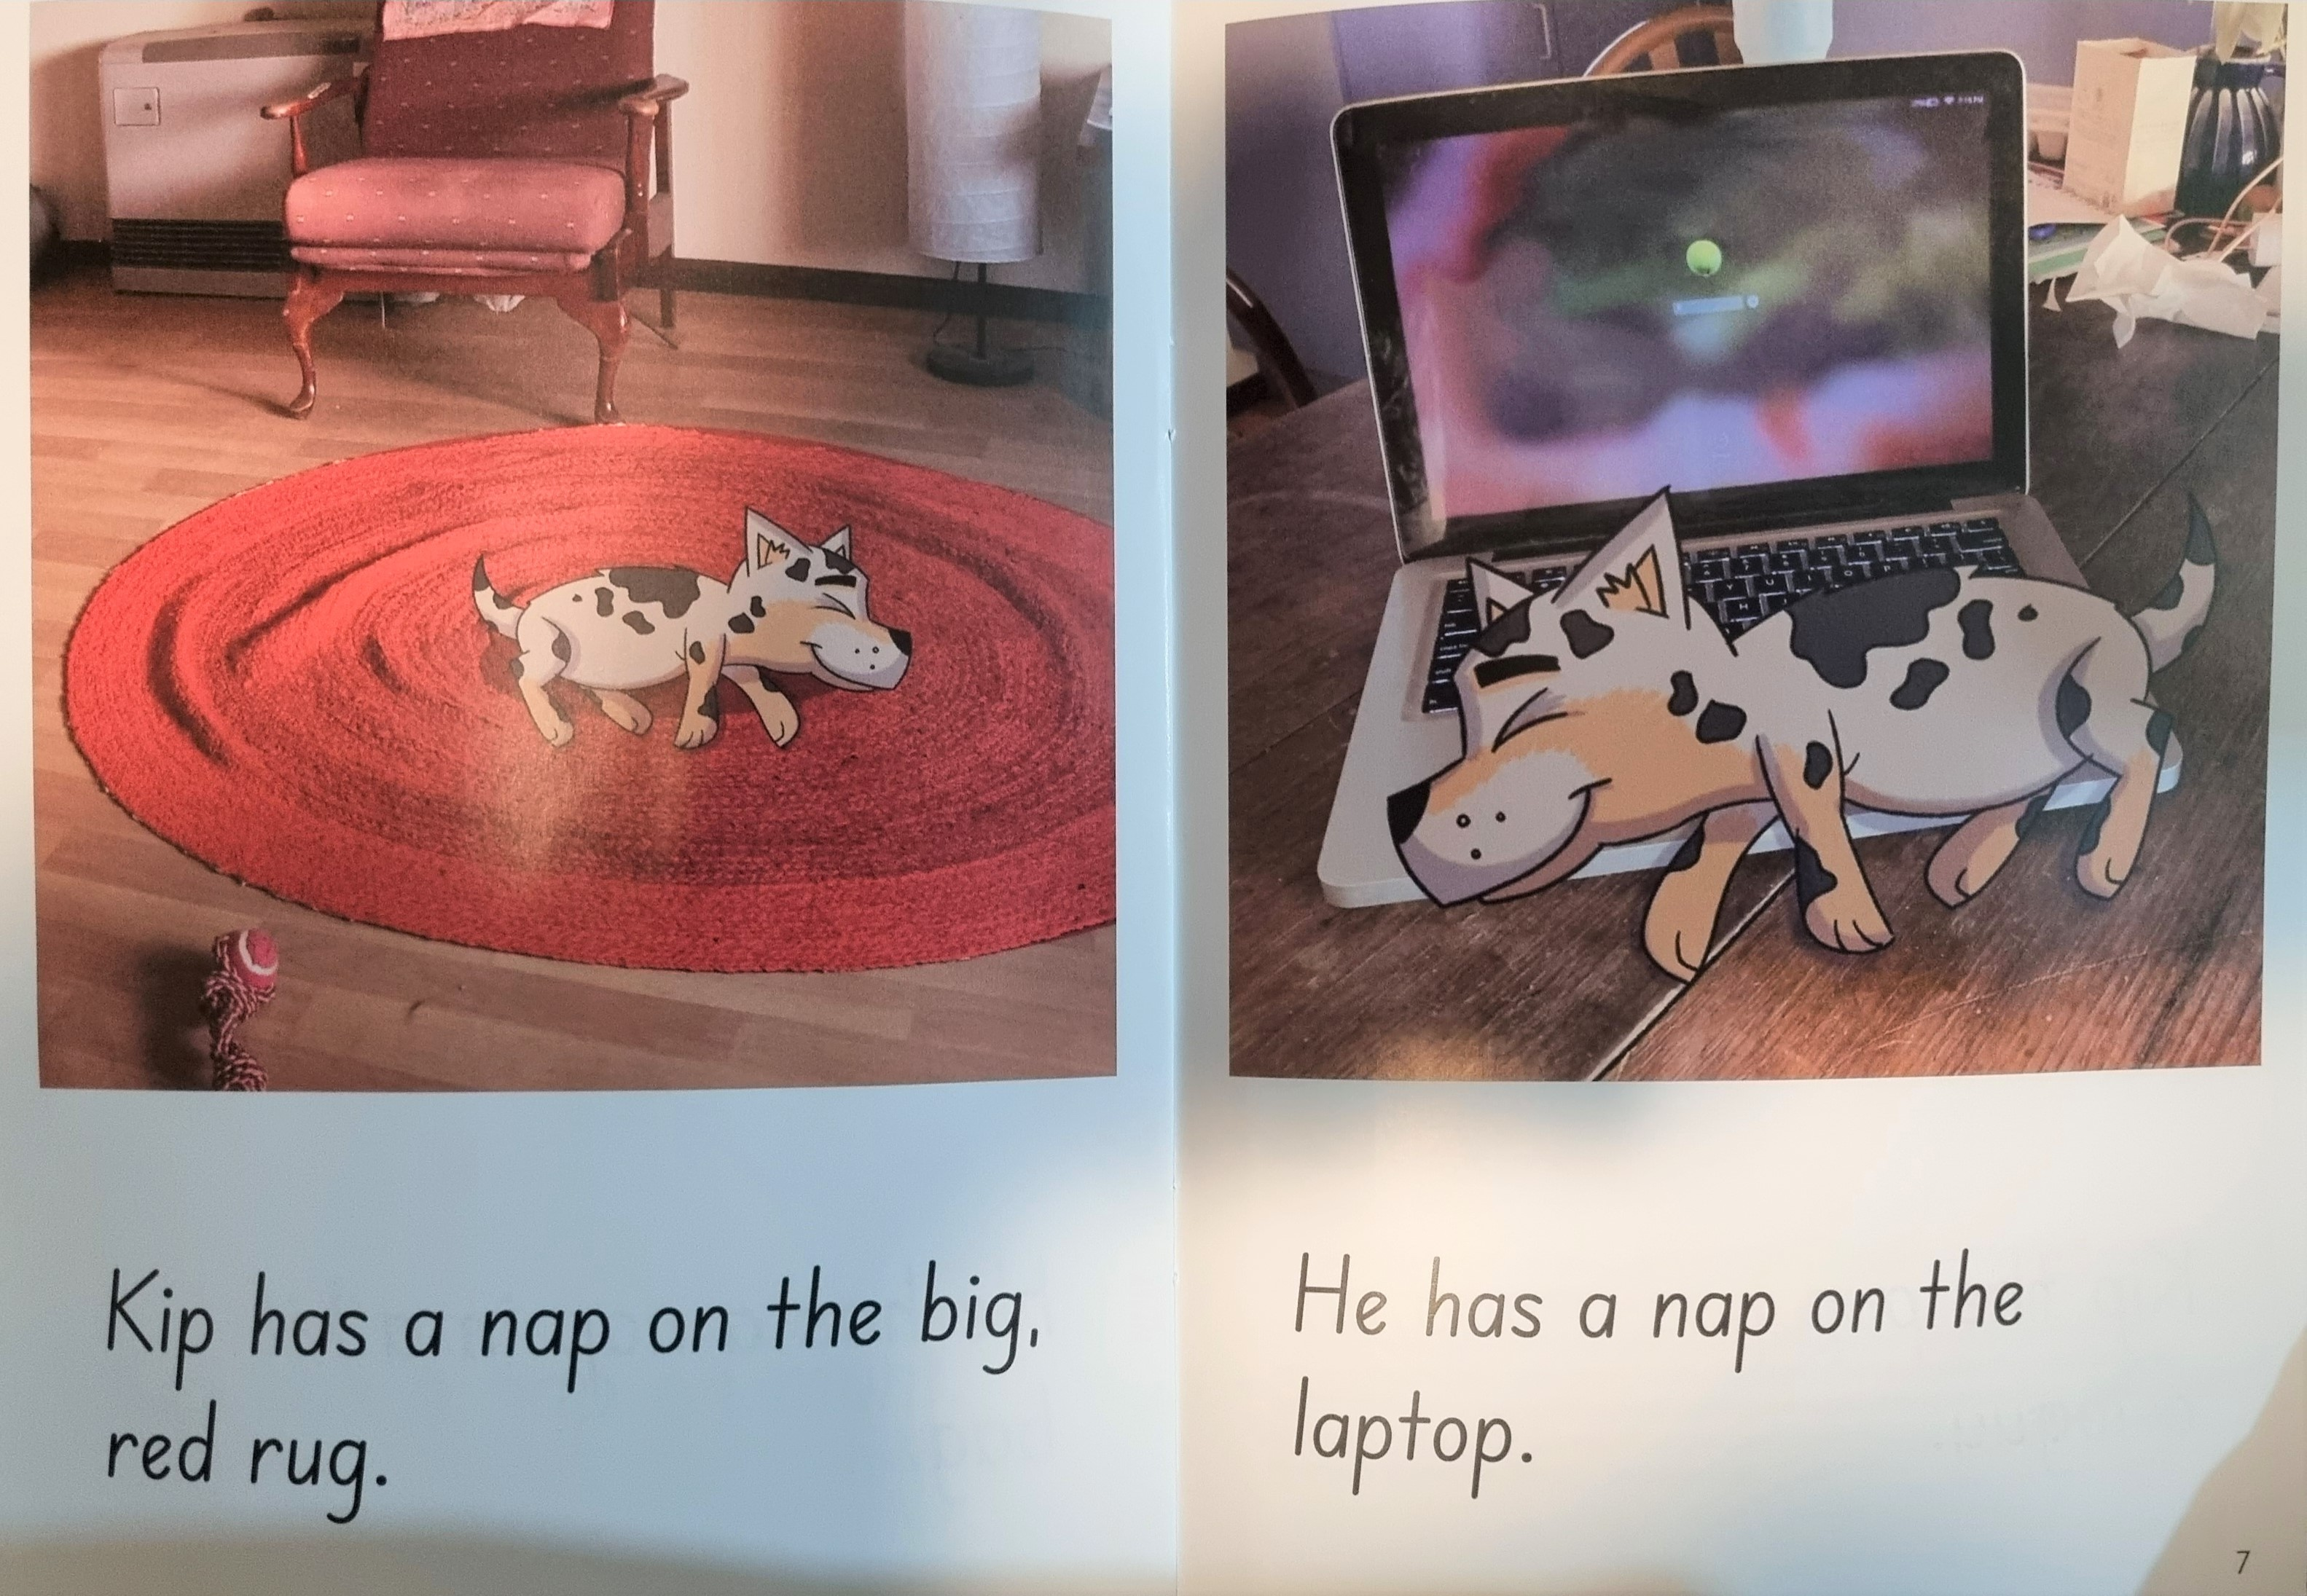
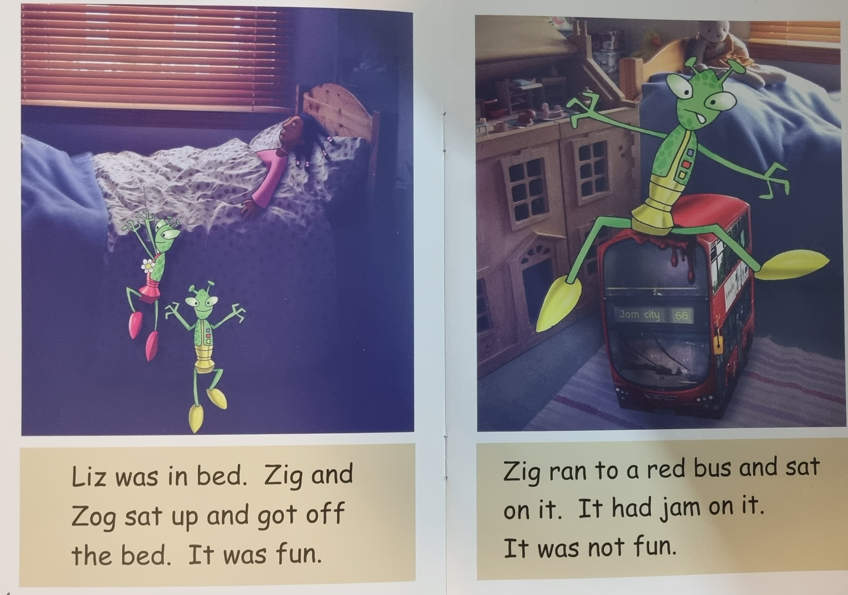
Decodable Readers

Slide 12
Decodable Readers
Decodable books are only a temporary tool to help build those circuits in the brain that link sounds and letters at speed
They are a bridge to fluent automatic reading that enables us to read authentic books
Notes:
(Read from slide)

Slide 13
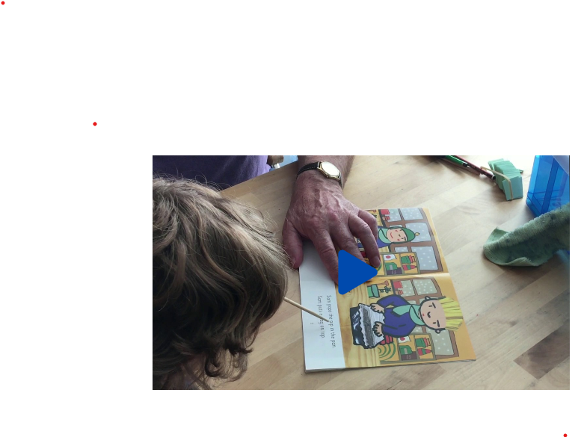
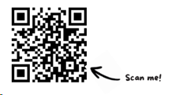
Supporting your child to read decodables
https://sounds-write.co.uk/decodables-help/
Notes:
Also, we strongly recommend that you do the free, online course ‘Help your child to read and write’, which has been specifically written by Sounds-Write to show parents how to help their children when using the Sounds-Write phonics program.
The course explains in a lot more detail some of what we have looked at today and gives you some step-by-step instruction on how to help your child, and how to correct mistakes if things go wrong.

Slide 14
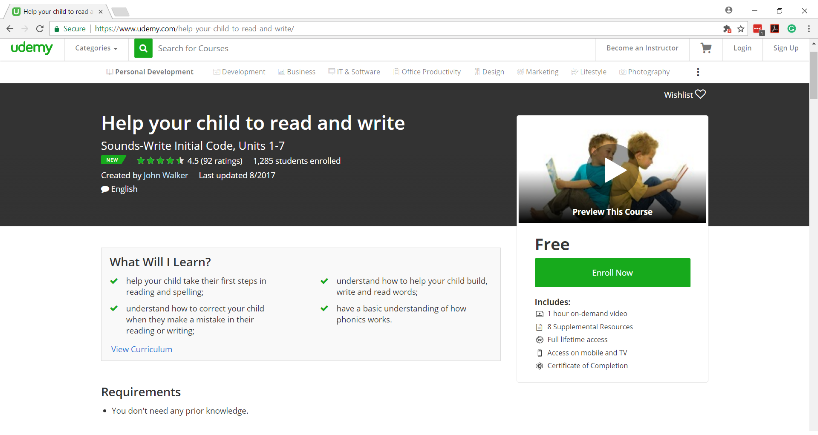
Free Sounds-Write parent course
https://www.udemy.com/help-your-child-to-read-and-write/
Notes:
Also, we strongly recommend that you do the free, online course ‘Help your child to read and write’, which has been specifically written by Sounds-Write to show parents how to help their children when using the Sounds-Write phonics program.
The course explains in a lot more detail some of what we have looked at today and gives you some step-by-step instruction on how to help your child, and how to correct mistakes if things go wrong.

Slide 15
Keep reading to your child
Notes:
Many dyslexic children have insufficient reading skills to read the books they are interested in. Reading aloud to them provides access to these stories as well as a pleasurable experience.
Hearing stories that are too hard for them to read independently at this stage also increases vocabulary and comprehension skills as you discuss what has been read.
There are also many free audiobooks available both online and in your local library that can help to give your child a love of books and reading.
.

Slide 16
Skills in Sounds-Write
The following skills need to be practiced and perfected to become a fluent reader:
Blending
Segmenting
Phoneme manipulation

Slide 17
Concepts in Sounds-Write
To become fluent readers and spellers children need to know:
1: Letters are used to spell individual sounds (one at a time, from left to right across the page).
2: Each sound may be spelled by one to four letters.
cat ship night weight

Slide 18
Concepts in Sounds-Write
To become fluent readers and spellers children need to know:
3: Sounds may be written in more than one way:
play, rain, great, gate
4: Many spellings represent more than one sound.
the spelling < ea > can represent the sounds:
seat, head, break
Notes:
Removes needs for lots of rules
Brings all kids along for ride
Reduce need for intervention need catch up and keep up groups

